Slide 1

IMPACTS On Health
Year 10 Health Lesson 1 Term 3, 2024

Slide 2
Term 3: Program & Assessments
Program:
Weeks 1 – 5: Impacts on Health
Weeks 6 – 10: Keys 4 Life
K4L will continue through to Term 4
Assessment:
Assessment Task 4: Impacts on Health
Analyse a health campaign
Due: Week 6

Slide 3

Download Student E-Workbooks
Log onto Connect.
Download E-book.
Open Adobe.
File open E-book from downloads.
Write your name.
File ‘save as’ – save book in health folder.
Exit and reopen to be sure your work saved.

Slide 4

Today’s Focus
Identify and define the 5 dimensions of health.
List factors that can impact each dimension.

Slide 5
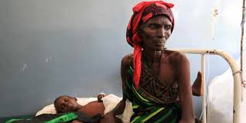
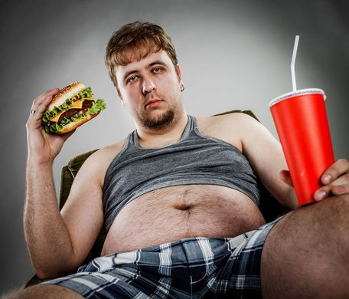
Who is healthier?
Notes:
Probably neither

Slide 6
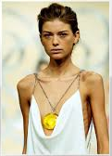
Who is healthier?
Notes:
Answer: Health is more than just a physical state. They may look the same, but there may be underlying issues that are causing different health problems or influencing their health promoting behaviours.

Slide 7

Snowball
Everyone will receive scrap paper.
Answer the question.
You can remain anonymous – optional to write your name.
Once you have written your answer, scrunch your paper into a ball.
Q: WHAT DOES HEALTH MEAN TO YOU?
What is health to you?
What does being healthy involve?
How can a person be healthy?
Notes:
Resources – scrap paper, pens
Everyone gets scrap paper.
Each student writes their own answer to the question on their paper.
Optional to write names.
They can use the extra questions on the slide to help answer the question.
Allow 1 minute for students to write their answer.
After that, allow students to have 10 seconds to throw their paper at each other --> a snowball fight.
Students keep throwing for the 10 seconds.
At the end of the allocated time, students are to pick up a new piece of paper. If everyone wrote an answer, everyone should pick one up.
Ask students to read theirs aloud.

Slide 9
Dimensions of health: (Pg. 7)
Physical
Social
Emotional
Spiritual
Mental
Health should be viewed as a holistic approach, meaning it is not just the absence of disease or illness etc.
It can be considered across 5 dimensions.
Collectively, they paint a picture of your overall health. A change in one dimension may potentially impact the other dimensions.
There are many factors that can be considered within each which ultimately can impact how healthy we are.

Slide 10

GLOSSARY: (Pg. 6)
At the front of your books is your glossary. Turn to your glossary and add the following words and their definitions:
Health:
A state of complete physical, mental, and social well-being and not merely the absence of disease or infirmity. (World Health Organisation)
Dimensions of Health:
The 5 dimensions of health help to provide a full picture of health and each dimension can impact another.
Holistic Health:
An approach to wellness that addresses all dimensions of health.
It considers the whole being of an individual.

Slide 11

Activity 1: Silent Ball
What dimension of health do you think that activity was related to?
Why? How does that activity link to that dimension?
Why is that dimension important for our health?
What else you think is included in that dimension?
How do you feel after that activity?
Notes:
ALTERNATIVE: Do the notes before the activities.
Play whatever activities you have time for / is appropriate for your class. (5mins max.)
Resources: a small ball (i.e., tennis ball, stress ball, bouncy ball)
Play silent ball with the class.
Incorporate rules such as jogging on the spot, clapping before catching etc.
Dimension = physical
Because = this activity involves physical activity. Physical activity is good for our physical health as it is a form of exercise. Physical activity also influences the mental/emotional dimension as well.

Slide 12

Activity 2: Two Truths, One Lie
What dimension of health do you think that activity was related to?
Why? How does that activity link to that dimension?
Why is that dimension important for our health?
What else you think is included in that dimension?
How do you feel after that activity?
Notes:
ALTERNATIVE: Do the notes before the activities.
Play whatever activities you have time for / is appropriate for your class. (5mins max.)
Give each student time to write down two truths and one lie about themselves.
Ask students to volunteer to share. The rest of the class needs to guess the truth and a lie.
Dimension = Social
Because = this activity involves sharing things about ourselves. When we share things, we get to know one another and learn something new and through that we build social connections and potentially therefore enhancing our social network/social lives/support network etc.

Slide 13

Activity 3: Community Circle
What dimension of health do you think that activity was related to?
Why? How does that activity link to that dimension?
Why is that dimension important for our health?
What else you think is included in that dimension?
How do you feel after that activity?
Notes:
ALTERNATIVE: Do the notes before the activities.
Play whatever activities you have time for / is appropriate for your class. (5mins max.)
Resources: emoji faces to be stuck up around the class (print your own in black and white – available on Connect/shared drive, or use the coloured set printed – available in the Health Store Room).
Community circle – ask the class a question and students answer by moving to the emoji that best suits how they feel towards to question. Ask students to think about why they feel that way and be ready to share:
Q1. How are you feeling about what is coming up this weekend?
Q2. How do you think you went in your schooling overall this year?
Q3. How are you currently feeling about starting year next year?
Q4. How are you feeling about what is coming up this weekend?
There is no right/wrong answer.
Dimension = Emotional
Because = this activity asks students to identify and reflect on their own emotions about something (the question). It also allows students to hear from others what they feel and why they feel a certain way about the same thing. Helps to create emotional awareness of their own and others emotions.

Slide 14

Activity 4: Puzzles
What dimension of health do you think that activity was related to?
Why? How does that activity link to that dimension?
Why is that dimension important for our health?
What else you think is included in that dimension?
How do you feel after that activity?
Notes:
ALTERNATIVE: Do the notes before the activities.
Play whatever activities you have time for / is appropriate for your class. (10mins max.)
Find a bunch of mind puzzles for students to do. Some have been saved and uploaded to Connect/Shared drive. Use these or find your own.
Colouring in can be used for this activity, or the spiritual dimension, as it helps calm a person or allow them to practice mindfulness.
Dimension = mental
Because = this activity is making students think, and is around the processing of their mind.

Slide 15

Activity 5: Meditation
What dimension of health do you think that activity was related to?
Why? How does that activity link to that dimension?
Why is that dimension important for our health?
What else you think is included in that dimension?
How do you feel after that activity?
Notes:
ALTERNATIVE: Do the notes before the activities.
Play whatever activities you have time for / is appropriate for your class. (5mins max.)
Find a meditation (Smiling Minds App, YouTube). Allow students to sit or lie on the floor or with their heads down on their desk. Ask students to remain where they are for the entirety of the meditation and stay silent as to not negatively impact the experience for those who are doing it properly.
Colouring in can be used for this activity, or the mental dimension, as it helps calm a person or allow them to practice mindfulness.
Dimension = Spiritual.
Because = meditation allows a person to connect with themselves therefore enhancing or getting in touch with their spiritual self.

Slide 16
Physical dimension of health: (Pg. 8)
Physical Health relates to the functioning of the physical body.
Includes factors such as:
Diet
Sleep
Injury and rehab
Hygiene
Exercise
Notes:
Students are to write these definitions in their books and include at least 3 factors of each.
ALTERNATIVE: Do the notes before the activities.

Slide 17

Social dimension of health: (Pg. 8)
Involves how we get along with other people.
Includes the ability to make and keep friends and good relationships with family/peers/colleagues.
It means communicating well, showing respect and care for self and others.
Notes:
Students are to write these definitions in their books and include at least 3 factors of each.
ALTERNATIVE: Do the notes before the activities.

Slide 18
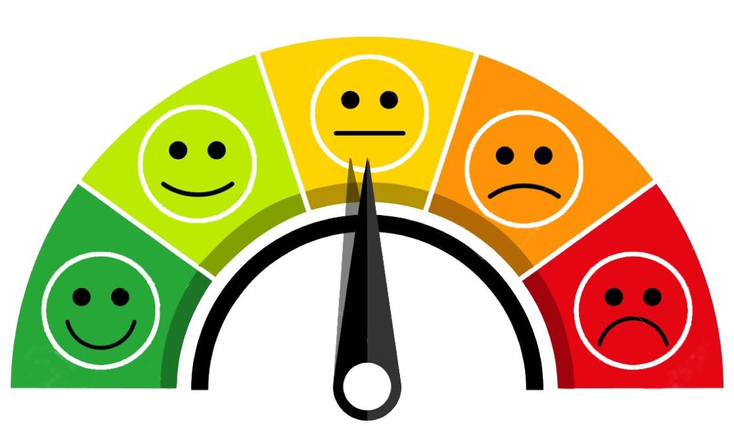
Emotional dimension of health: (Pg. 8)
Encompasses the knowledge and skills to identify personal feelings and the ability to handle those emotions.
Connected to mood.
Also includes the ability to understand other people’s emotions.
Includes factors such as:
Our emotions – i.e., happy, sad, angry etc.
Understanding why we may feel a certain way.
Ability to be empathetic and sympathetic.
Notes:
Students are to write these definitions in their books and include at least 3 factors of each.
ALTERNATIVE: Do the notes before the activities.

Slide 19
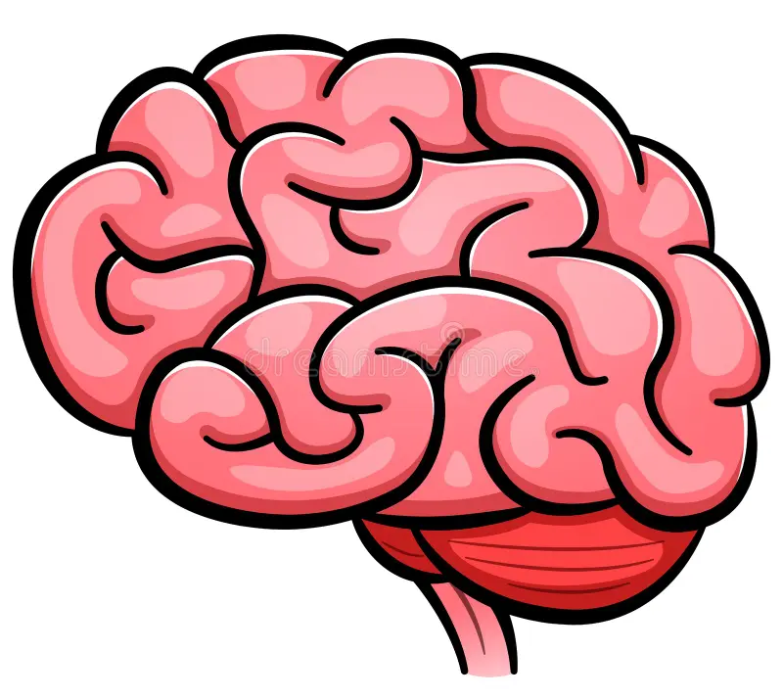
Mental dimension of health: (Pg. 8)
Mental refers to the cognitive aspect of health.
More around the functioning of the brain – thoughts, behaviours and processing of the mind.
Our ability to cope with daily demands – stress, change, problems etc.
Includes factors such as:
Goal setting
Knowledge
Decision making
Problem solving
Addiction
Mental health
Notes:
Students are to write these definitions in their books and include at least 3 factors of each.
Mental Health could be considered in the emotional dimension but, often mental illnesses cause the mind to work differently, therefore can fall under this dimension.
ALTERNATIVE: Do the notes before the activities.

Slide 20
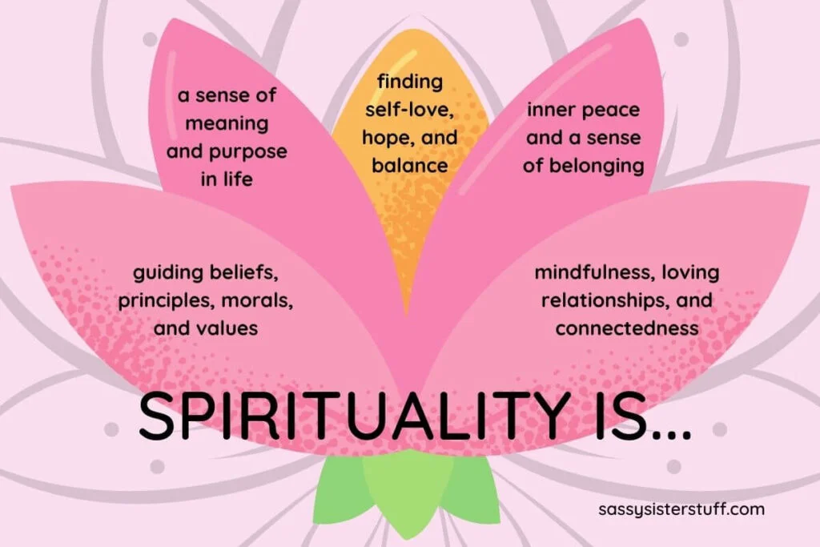
Spiritual dimension of health: (Pg. 8)
The need for meaning, purpose and fulfilment in life.
Includes factors such as:
Hope
Religion
Meaning in life
Contentment
Beliefs and morals
Peace
Notes:
Students are to write these definitions in their books and include at least 3 factors of each.
ALTERNATIVE: Do the notes before the activities.

Slide 21

Reflection: (PG.8)
In your workbooks, reflect on your own holistic health and answer the questions below:
Which dimension of health do you feel you thrive in the most?
Which dimension of health do you feel you could improve and why?

Slide 22
IMPACTS On Health
Year 10 Health Lesson 2 Term 3, 2024

Slide 23
Today’s Focus
Define risk factors for health.
Consider how obesity can impact on the dimensions of health.
Introduction to the determinants of health.

Slide 24

HOOK: Dimensions of Health Review
Q1: What is Holistic Health?
Looking at the health of a whole person, not just the absence of disease or infirmity.
Q2: Name one dimension + give its definition.
Physical
Social
Emotional
Spiritual
Mental
Notes:
Ensure students have their books closed.
Ask each question separately to the class.
Correct answers = lollies

Slide 25
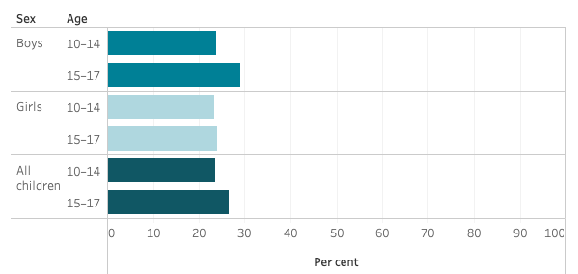
Obesity in Australia - Adolescents in review:
29% of boys aged 15-17 are overweight or obese.
Proportion of children and adolescents aged 2–17 living with overweight and obesity, by age group and sex, 2017–18
24% of girls aged 15-17 are overweight or obese.
What does the graph tell us about adolescent weights?
26% of the adolescent population, aged15-17 are overweight or obese.
Notes:
OPTIONAL Discussion
https://www.aihw.gov.au/reports/overweight-obesity/overweight-and-obesity/contents/overweight-and-obesity
Data is from 2017-2018 as covid impacted recording in 2020-2021.

Slide 26
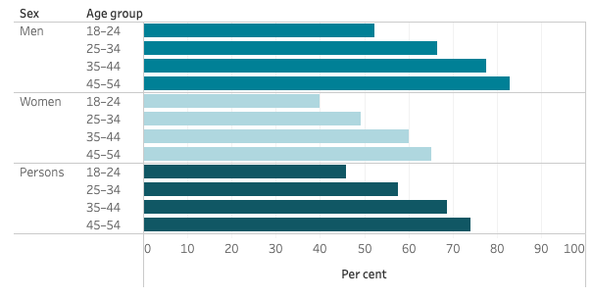
Obesity in Australia - Adults in review:
Proportion of adults living with overweight and obesity, by age group and sex, 2017–18
What does the graph tell us about adult weights?
Obesity rates increase with age.
Why is this a significant fact?
Our health when we are young can have a significant impact on our health as we get older.
Notes:
OPTIONAL Discussion
https://www.aihw.gov.au/reports/overweight-obesity/overweight-and-obesity/contents/overweight-and-obesity
Data is from 2017-2018 as covid impacted recording in 2020-2021.

Slide 28
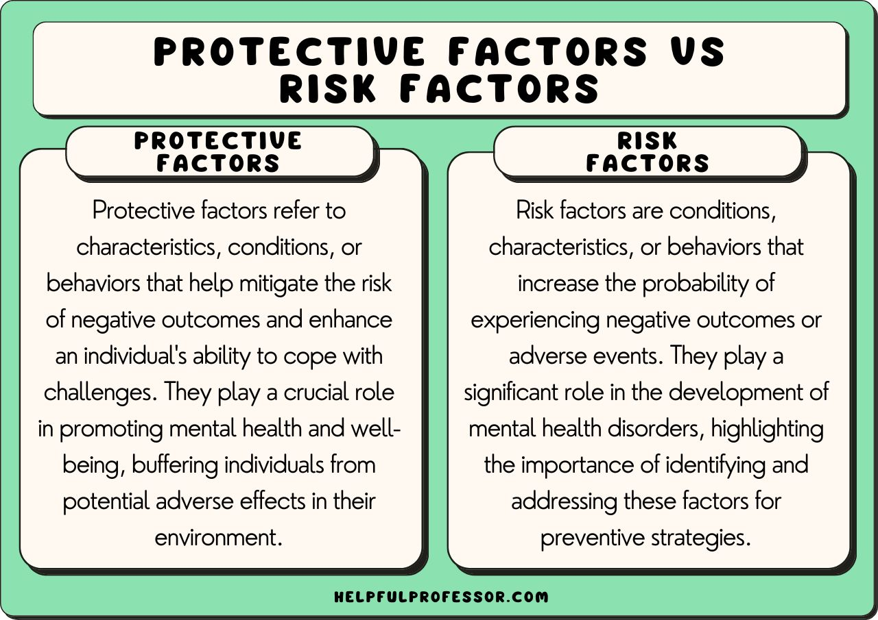
Risk factors: (Pg. 9)
There are a range of factors that can contribute to poor health outcomes.
Risk factors are a factor that increases the risk of developing something negative.
For example, a risk factor for skin cancer is tanning in the sun with no sunscreen or having a family history of skin cancer.
Tanning and family history are both factors that can increase the risk of developing skin cancer.

Slide 29
GLOSSARY: (Pg. 6)
At the front of your books is your glossary. Turn to your glossary and add the following words and their definitions:
Risk factor:
A factor that increases the risk of a person developing a disease or condition.

Slide 30
Activity 1: risk factors for OBESITY (Pg. 9) Risk factors = a factor that increases the risk of developing something. What increases the risk of a person becoming overweight or obese? In your books, brainstorm a list of factors that can contribute to obesity:
Not enough exercise → output of energy
Too much bad/junk food
Biological factors:
Age
Gender
Race/ethnicity
Genetics
Obesity: Risk Factors
Poor sleep
Sedentary lifestyle
(not much moving around)
Excessive food/drink
Too much alcohol
Other health conditions
High stress
Notes:
Too much bad/junk food
Excessive food/drink :intake of energy
Not enough exercise :output of energy
Too much alcohol
Hereditary

Slide 31
Activity 2: Causes of risk factors (Pg. 9) You have considered what the risk factors of obesity are. Now brainstorm the causes of those risk factors. In your books, brainstorm causes for those risk factors. Why do they exist? Why are they a problem? An example has been completed for you.
Parent genetics
Peer pressure – eating junk food after school with mates
Low income – can’t buy healthier options
Social norms – what’s considered socially normal in Aus. Society (i.e., pies and sausage rolls, lots of alcohol)
Little knowledge of what is healthy and unhealthy/risks of alcohol (education)
No access to green spaces to exercise/poor living environment
Causes of
Obesity Risk Factors
Close proximity to take away/junk stores
Low paying jobs – poor income
Live too far away from sporting associations
Cultural norms – Family traditions/cultures: large meals at dinner time, overeating
Stress – poor eating habits
Family beliefs/values – little emphasis put on healthy eating, eating properly, alcohol consumption
Low income – can’t afford sport or gyms
Notes:
Peer pressure – eating junk food after school with mates
Family traditions/cultues – large meals at dinner time, overeating
Country norms – pies and sausage rolls, lots of alcohol
Low income – can’t buy healthier options
Low income – cant afford sport or gyms
Live too far away from sporting associations
Parent genetics
Stress – poor eating habits
Low paying jobs – poor income
Family beliefs/values – little emphasis put on healthy eating, eating properly, alcohol consumption
No access to green spaces to exercise/poor living environment
Close proximity to take away/junk stores
Little knowledge of what is healthy and unhealthy/risks of alcohol (education)

Slide 32
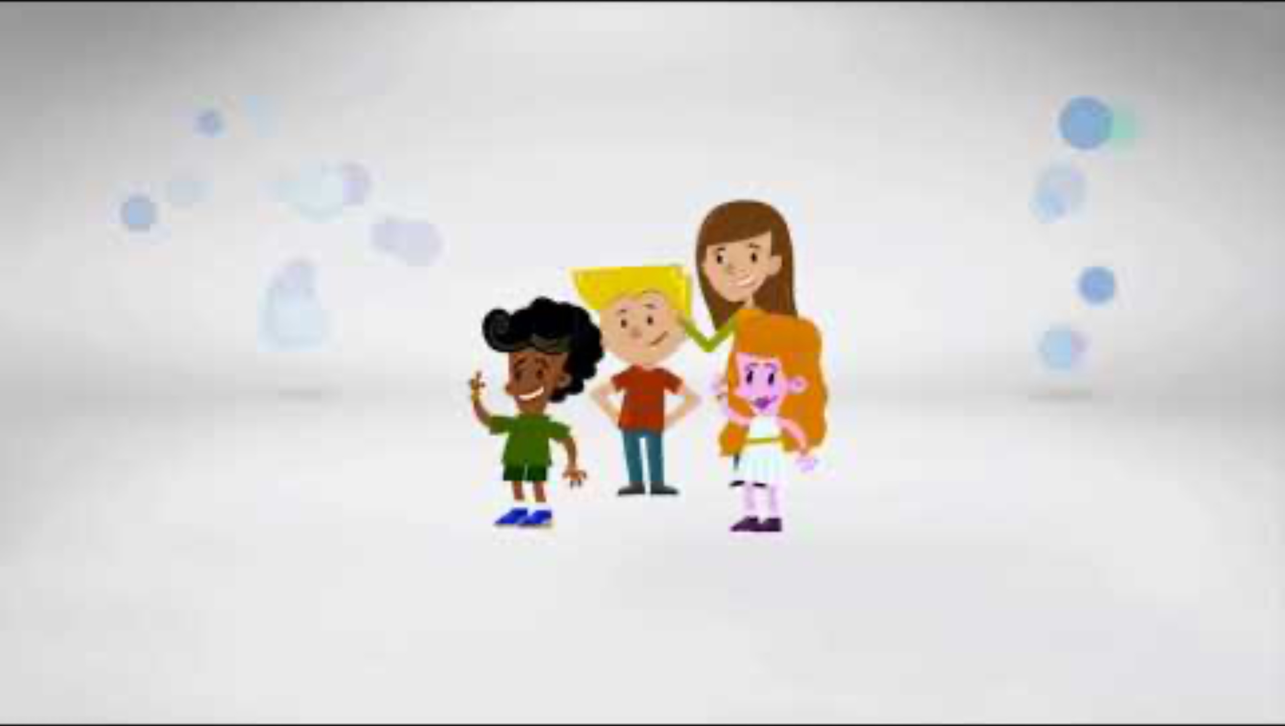
Determinants of health.
Notes:
OPTIONAL
Start at 1:15min
https://www.youtube.com/watch?v=LP32-90UClk&t=75s

Slide 33
GLOSSARY: (Pg. 6)
At the front of your books is your glossary. Turn to your glossary and add the following words and their definitions:
Determinants of Health:
Factors in our life that can be in or out of our control and can have a positive or negative impact on our health.

Slide 34
Determinants of health:
Many factors combine together to affect the health of individuals and communities.
Whether people are healthy or not, is determined by their circumstances and environment.
To a large extent, factors such as where we live, the state of our environment, genetics, our income and education level, and our relationships with friends and family all have considerable impacts on health, whereas the more commonly considered factors such as access and use of health care services often have less of an impact.
All of these things that can play a role in determining our health, are the determinants of health.
Notes:
https://www.who.int/news-room/questions-and-answers/item/determinants-of-health#:~:text=What%20are%20the%20determinants%20of,person's%20individual%20characteristics%20and%20behaviours.

Slide 35
Determinants of Health: (Pg. 10)
Social – factors involving culture, family, support networks, social/group environment etc.
Environmental – involving natural or geographical factors, climate, the built environment such as industrial or housing area and conditions, access to areas such as parks or day to day conveniences etc.
Socioeconomic – factors involving combination of income, education, and employment etc.
Biological – genetic factors, previous family history, birth complications, race (predisposition of certain races to particular health problems), skin colour (especially for skin cancer) etc.

Slide 36

Socioeconomic impacts on health
http://www.unnaturalcauses.org/video_clips_detail.php?res_id=409
While watching the video, add anything new to your definition on pg.10
Notes:
OPTIONAL
http://www.unnaturalcauses.org/video_clips_detail.php?res_id=409
4:04mins

Slide 37
Environmental impacts on health
http://www.unnaturalcauses.org/video_clips_detail.php?res_id=71
While watching the video, add anything new to your definition on pg.10
Notes:
OPTIONAL
http://www.unnaturalcauses.org/video_clips_detail.php?res_id=71
1:34mins

Slide 38
Neighbourhood impacts on health
http://www.unnaturalcauses.org/video_clips_detail.php?res_id=217
While watching the video, add anything new to your definition on pg.10
Notes:
OPTIONAL
http://www.unnaturalcauses.org/video_clips_detail.php?res_id=217
3:35mins

Slide 39
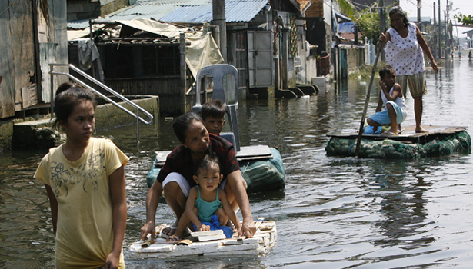
Which determinants of health are impacting the health of the individuals in this image?
Notes:
Class discussion
Social:
May have social support as they have a family and others around them in a similar situation.
Environmental:
Floods and natural disaster have impacted their homes and transport/roads/infrastructure. Lack of transport and roads means inability to get to or from work, or even the shops to get food and supplies.
Their housing might not be safe. Damp environments can encourage mould growth, can make buildings unstable etc.
Socioeconomic:
Inability to work would impact income.
Impacted transport systems would impact the resources able to get to and from the town.
Looks like a low socioeconomic area/country which may mean less access to services as it is.

Slide 40

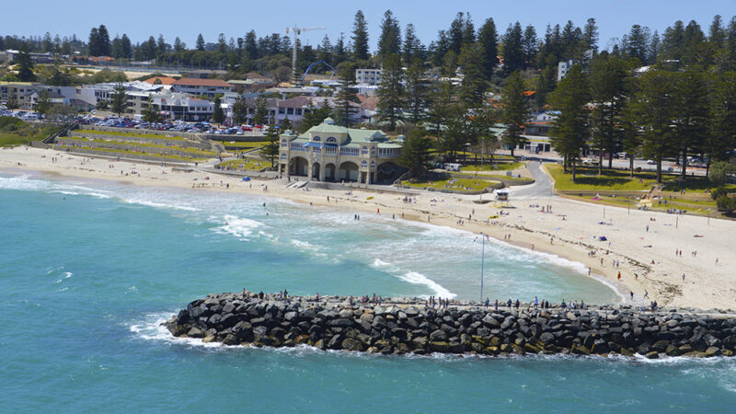
Sally is a 35-year-old single woman who runs a successful company. She lives in Perth and moved here 3 years ago but the rest of her family live over east. Since moving to Perth, she has been busy setting up her business and hasn’t had the most time to explore. Sally owns her newly built single-story home in Cottesloe near the beach and pays her mortgage on her own.
Which determinants of health are impacting the health of Sally with the information provided?
Notes:
Class discussion
Social:
- Not a lot of social support as her family is living interstate. Being a busy person who hasn’t had time to explore could suggest that she doesn’t have a big social circle.
Environmental:
- Lives in a nice, new home in a good suburb. Cottesloe is close to the beach and is a well-developed suburb so there will be lots of services and facilities in her area.
Socioeconomic:
- Could assume being a business owner Sally has a good, stable income. This could also be assumed as she can afford to have a mortgage on her own in a good suburb.
- Could also assume that her mortgage is high and that she may need to budget accordingly. This could then impact her social activities and if she can afford them etc.

Slide 41
Identify the Determinants of Health impacting Obesity: (Pg. 11)
Social
Environmental
Socioeconomic
Biological
Think about the factors that can contribute to obesity.
Categorise them into the determinant they best fit into.
TIP:
Take a look back at the risk factors and causes of risk factors that were identified earlier and which category of determinants they could fit under…

Slide 42
Identify the Determinants of Health impacting Obesity: (Pg. 11)
Transport – walking vs. driving
Social support – friendship groups and peer influences
Food choices
Cultural events/expectations
Neighbourhoods and greenspace – are there local gyms or parks?
Neighbourhood safety – can they exercise outside safely?
Is the climate conducive to being able to exercise outdoors?
Job type – sedentary office job vs. gym trainer vs. PE teacher
Enough income to be able to afford nutritious foods.
Enough income to be able to afford gym memberships etc.
Enough time to cook healthy meals.
Education/knowledge of how to eat healthy and exercise effectively.
Genetics can impact conditions like high blood pressure, cholesterol, and weight loss.
Notes:
Allow 5 mins for students to work together.

Slide 43

Reflection: (PG.11)
Think of 3 things you currently do in your life to stay healthy.
Think of 3 things you could do better in your life to stay healthy.

Slide 44
IMPACTS On Health
Year 10 Health Lesson 3 Term 3, 2024

Slide 45
Today’s Focus
Review determinants of health.
Compare impacts of rural and metropolitan living on health.

Slide 46
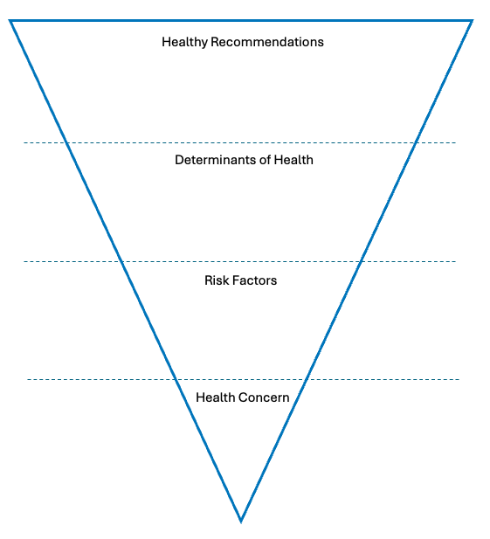
Hook/review: (PG.12)
Choose a health condition
i.e., cardiovascular disease, skin cancer, asthma, dementia, diabetes, depression, lung cancer etc.
For that condition…
Identify the risk factors for your chosen health condition.
Identify the determinants of health at play that can affect this health condition.
Identify ways or behaviours to improve health for this condition/how can risk factors be minimised?
You have 10 mins.
Use the triangle in books to compile your answer. Be prepared to share.

Slide 47
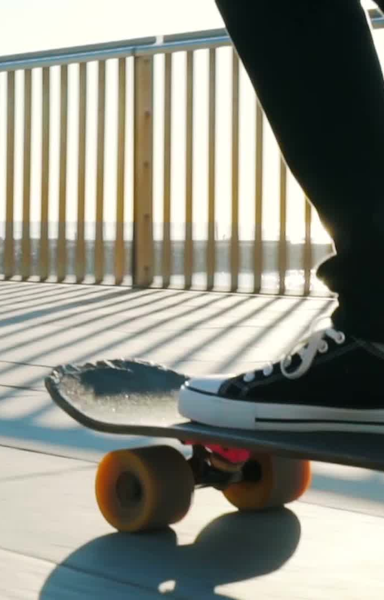
A story about determinants: (PG.13)
“Why is Jason in the hospital?
Because he has a bad infection in his leg.
But why does he have an infection?
Because he has a cut on his leg, and it got infected.
But why does he have a cut on his leg?
Because he was playing in the junk yard next to his apartment building and there was some sharp, jagged steel there that he fell on.
But why was he playing in a junk yard?
Because his neighbourhood is kind of run down. A lot of kids play there and there is no one to supervise them.
But why does he live in that neighbourhood?
Because his parents can’t afford a nicer place to live.
But why can’t his parents afford a nicer place to live?
Because his dad is unemployed, and his mum is sick.
But why is his dad unemployed?
Because he doesn’t have much education and he can’t find a job.
But why …?”
Notes:
This story is to show how all the different factors/behaviours/events in a persons life can impact their health. This is an example of how Jason’s life was negatively impacted.

Slide 48
A story about determinants: (PG.13)
The health of Jason was impacted negatively by several factors:
Family values/social lifestyle/how he lives – SOCIAL DETERMINANTS
Living/built environment/where he lives – ENVIRONMENTAL DETERMINANTS
Family income – SOCIOECONOMIC DETERMINANTS
Unemployment – SOCIOECONOMIC DETERMINANTS
Education – SOCIOECONOMIC DETERMINANTS
Notes:
This story is to show how all the different factors/behaviours/events in a persons life can impact their health. This is an example of how Jason’s life was negatively impacted.

Slide 49
Activity 1: Turn Jason’s Life Around (PG.13)
Write your own story for Jason (or yourself).
Write it in the same style as before but put a positive spin on it and make note of how the different dimensions are positively impacting on his life.
For example…
“Why is Jason in the hospital?
Because he fell off his bike at the skate park. → Enjoys spending time outdoors, adventurous (environmental determinant)
But why did he fall off his bike?
Because he was showing off in front of his friends. → Has close friends and a support network (social determinant)
5 minutes.

Slide 50

Activity 2a: Metropolitan vs. Rural & Remote Health Outcomes (PG.14)
Where we live is considered the metropolitan region of Perth.
Think about where you live and what is around you.
Write a list of all the things that are close to your area that can impact your heath.
Positive or negative impacts.
Think about all the determinants of health we have spoken about.
Don’t forget to consider all 5 dimensions of health.
Use Google Maps if you need to.
Include an explanation on how it impacts health and where possible, link to determinants of health.
E.g., local parks which allow us to play outside with friends and get fresh air. These are positive as they are beneficial for our physical health, social health and even emotional health.
E.g., Access to lots of transport options such as cars, buses or trains can be beneficial in helping get to work/school etc. which is evidence of a socio-economic determinant impact, but can negatively impact our physical health through pollution etc.
Be prepared to share your answers.
Notes:
Allow 3 minutes to list everything in their community.
Allow an additional 5 minutes to explain its impact.
Examples:
Fiona Stanley Hospital & St. John of God Murdoch
Public transport – buses and trains.
Other medical facilities – doctor's surgeries, dentists, physio’s etc.
Movie cinemas
Shopping centers – groceries and clothes etc.
Parks and ovals
Rec centers
Schools
Fast food restaurants
Etc.

Slide 51
Activity 2b: Metropolitan vs. Rural & Remote Health Outcomes
The death rates for a range of diseases is higher in remote Australia.
Death rates from the major causes of death in Australia are significantly higher in remote communities when compared with major cities:
» Land transport accidents – almost five times more deaths in remote Australia
» Diabetes - three times the number of deaths in remote Australia
» Suicide - twice the number of deaths due to suicide in remote Australia
» Chronic obstructive pulmonary disease – 60% higher death rate in remote Australia
» Coronary heart disease – 40% more deaths in remote Australia
» Lung cancer – the rate is 40% more deaths in remote Australia.
People in remote Australia die around three years earlier than people in the city.

Slide 52
Activity 2b: Metropolitan vs. Rural & Remote Health Outcomes (PG.15)
Why do these statistics exist the way that they do?
What factors can contribute to the poor health of those living in rural Australia (when compared to those living in the city?)
Less access to services.
Less access to education.
The population in rural areas has a higher proportion of Indigenous Australians, therefore there could be cultural impacts on access to education etc.
Potentially less work available.
Less health care facilities.
Less emergency services available.
More exposure to extreme weather (drought, floods etc.)
Less safety measures on road – on remote roads, drivers tend to speed more and there is less street lighting.
Higher crime rates.
Food is more expensive.
Social isolation.
Notes:
Write factors into their books.

Slide 53
Activity 2b: Metropolitan vs. Rural & Remote Health Outcomes (PG.15)
Choose one of the health issues listed below:
Land transport accidents.
Diabetes.
Suicide rates.
Coronary heart disease.
Lung cancer.
Research the risk factors that contribute to your chosen health issue in rural Australia.
Identify the determinants of health at play.
10 mins.
Notes:
OPTIONAL

Slide 54
Activity 3: ‘In my blood it runs’ (PG.16)
Watch film ‘In My Blood It Runs’
https://clickv.ie/w/T1cq
Complete the worksheet in your books while watching.
Notes:
OPTIONAL activity.
1hour 20mins.
Good for a relief lesson.

Slide 55

EXIT TICKET:
On a sticky note, list 3 factors in your community that influence your health the most.
Raise your hand and show your teacher before you pack up.
Notes:
Sticky notes

Slide 56
IMPACTS On Health
Year 10 Health Lesson 4 Term 3, 2024

Slide 57
Today’s Focus
Evaluate the influence of media on health
Define health promotion
Analyse existing health promotion campaigns

Slide 58

POST IT SLAM!
Health behaviours = the way we act that affects our health.
e.g., sun tanning is a health behaviour that can cause skin cancer.
e.g., showing a person getting injured while drunk may deter people from drinking too much.
Everyone will receive a sticky note.
On your sticky note answer the question:
Once you have written your answer, stick your note on the board.
Name is optional.
You have 2 minutes.
How does the media influence our health behaviours?
Think about the techniques used by the media, or what the media does to make us act in a certain way.
Notes:
Resources – sticky notes
Answers – celebrity endorsements, advertising on social media, tv ads, movie ads, products in movies, billboard advertising, radio advertising, use slogans or jingles, advertises the effects/outcomes of using a product etc.

Slide 59

ACTIVITY 1: Media and impacts on health (PG.17)
Media includes radio, TV, movies, newspaper, billboards, music, books, etc.
Media can use a range of strategies / techniques to make the audience feel or act in a certain way.
Consider the positive and negative impacts that media can have on health.
Write at least 3 examples of positive impacts media can have and 3 examples of negative impacts on health.
You have 3 minutes.
Notes:
Examples:
Positive – advertisement creates awareness around unhealthy behaviours (drink driving ads), advertises new health products, helps to encourage change by the promotion of the healthy behaviours, creation of apps can enhance health (i.e., fitness tracking, recipes, health monitoring etc.)
Negative – fast food advertisements make us want unhealthy food which can lead to health issues (diabetes), unrealistic expectations of products/behaviours (we see something advertised and want the same outcome but mightn’t be able to achieve it), increasing use of media (gaming, streaming etc.) and social media can lead to a more sedentary lifestyle, the impacts on mental health due to social media etc.

Slide 60

What is health promotion? (PG.18)
Health promotion is the process of enabling people to increase control over, and to improve, their health.
It raises the awareness of health issues within a community by bringing attention to it.
One part of health promotion is the creation and use of health promotion campaigns to educate individuals on what they need to do and how to do it, so they can be healthy.
Health promotion campaigns can be presented to the public using media.
Other health promotion interventions include policy development, legislation and regulation, re-orienting health services, community development.

Slide 61
GLOSSARY: (Pg. 6)
At the front of your books is your glossary. Turn to your glossary and add the following words and their definitions:
Health Promotion:
The process of enabling people to increase control over, and to improve, their health.
Health Campaign:
Aims to raise awareness and understanding of a health issue, and often aims to change people’s health behaviours.
This can be done in several ways: through mass media, social media and community events.

Slide 62
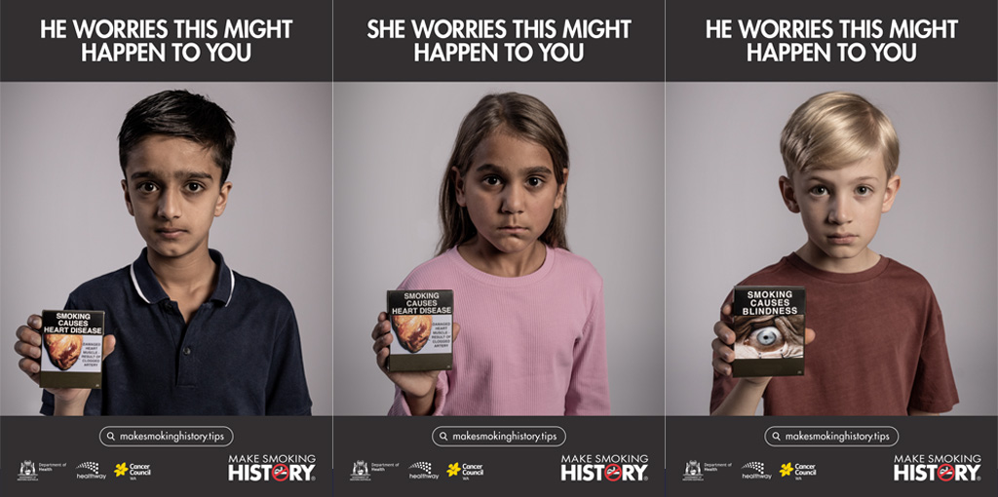
Activity 2: Existing Health Promotion campaigns (PG.18)
Health campaigns are an integral part of Health Promotion. They are designed to promote positive behaviour change within a target audience; for example, an individual, specific groups, or whole populations. Behaviour change does not just occur over night and therefore campaigns need to be sustained over long periods of time. ‘Make Smoking History’ has been an on-going campaign for over 20 years and its continued campaign push is why Australia now has such low rates of smoking.
You have 2 minutes to think of as many health promotion campaigns you can think of.
You can chat with your peers but don’t use the internet – see what you can think of!
Think of campaigns you have seen on TV, advertised at sporting events, heard on the radio…

Slide 63





Activity 3: Campaign analysis (PG.19-20)
Watch the following health promotion campaign adverts.
Complete the questions in the table as you go.
Name of campaign
Target Audience
Intended behaviour change
Do you think it’s effective? Why/Why not?
Notes:
Complete one together as a class.
There are 5 videos – optional to do all 5. Try to complete at least 2 (do what time allows for).
Obesity
Cowards Punch
Violence against women
Smoking
Drinking while pregnant

Slide 64
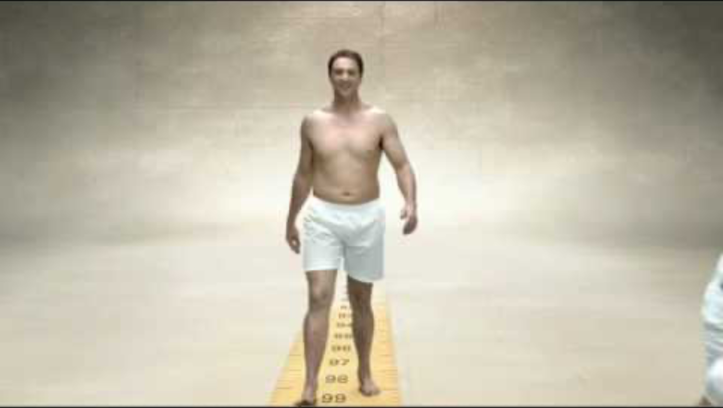
Notes:
Complete this one as a class
https://www.youtube.com/watch?v=9dL4lN6GKi4
1minute
Measure Up.
Adults who are overweight with young families or family members of overweight people.
Reduce obesity and draw attention to the potential consequences of obesity.

Slide 65

Notes:
https://www.youtube.com/watch?v=qCaAY4XLAFI
0:30seconds
Cowards Punch.
Typically, males who drink and resort to violence.
Walk away, don’t resort to violence and one punch can kill someone.

Slide 66
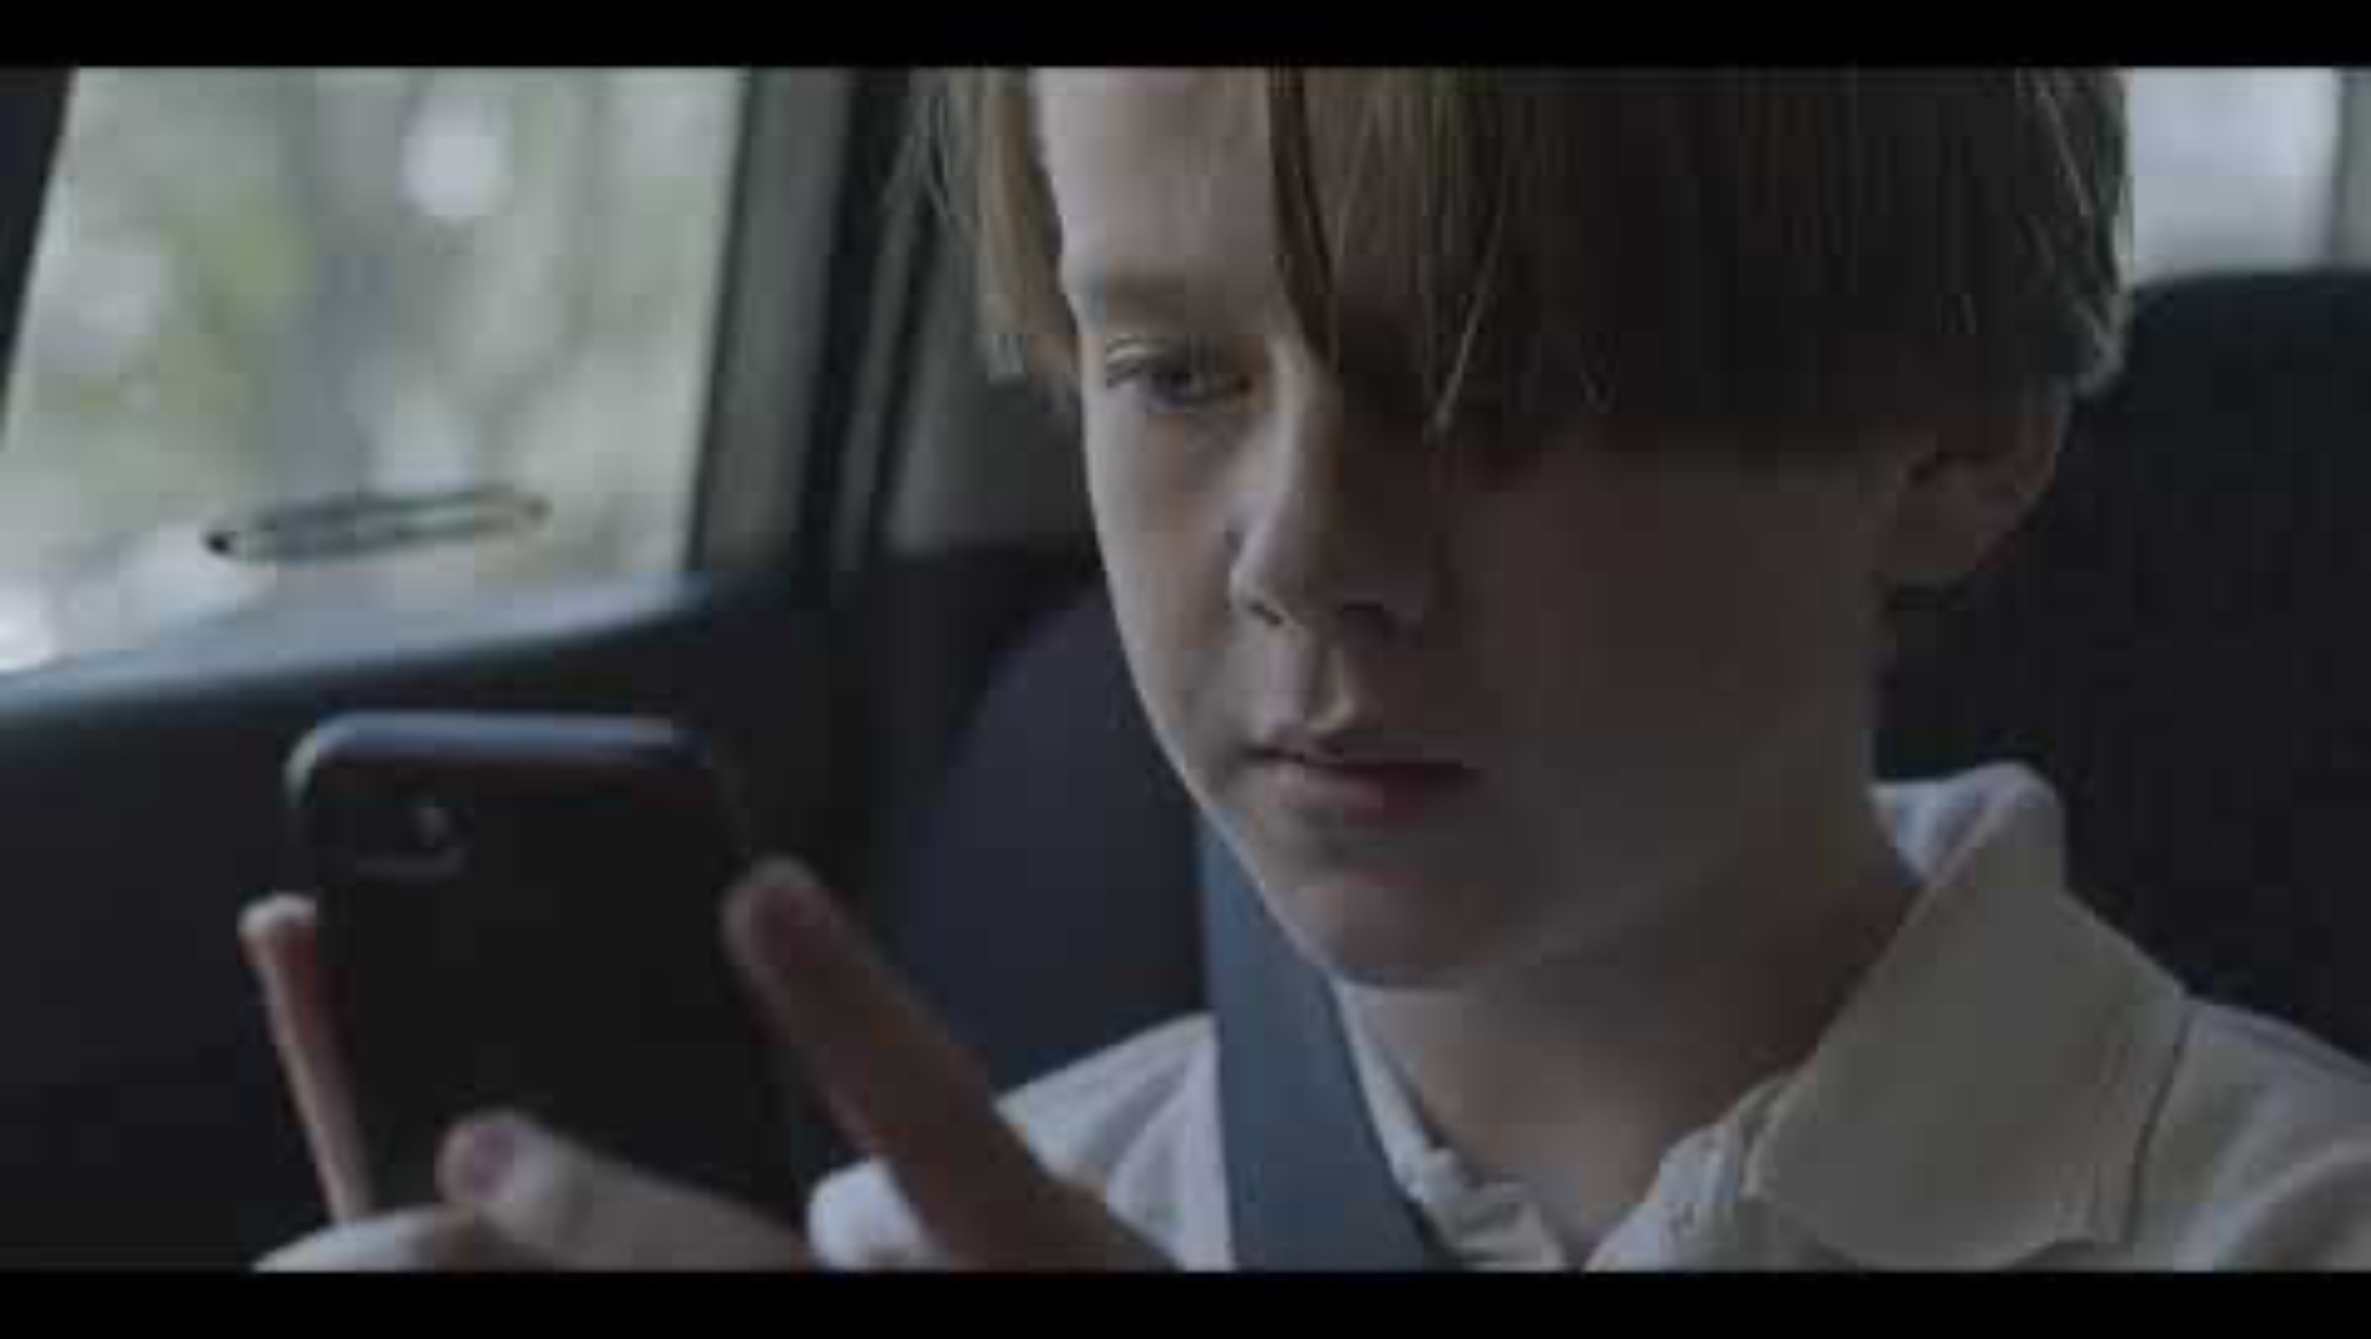
Notes:
https://www.youtube.com/watch?v=_HFbOXSLFvw
0:45secs
Stop It At The Start
Young men, parents with young children.
Teach respect young so poor behaviours don’t continue when they get older and protect the safety and wellbeing of women.

Slide 67
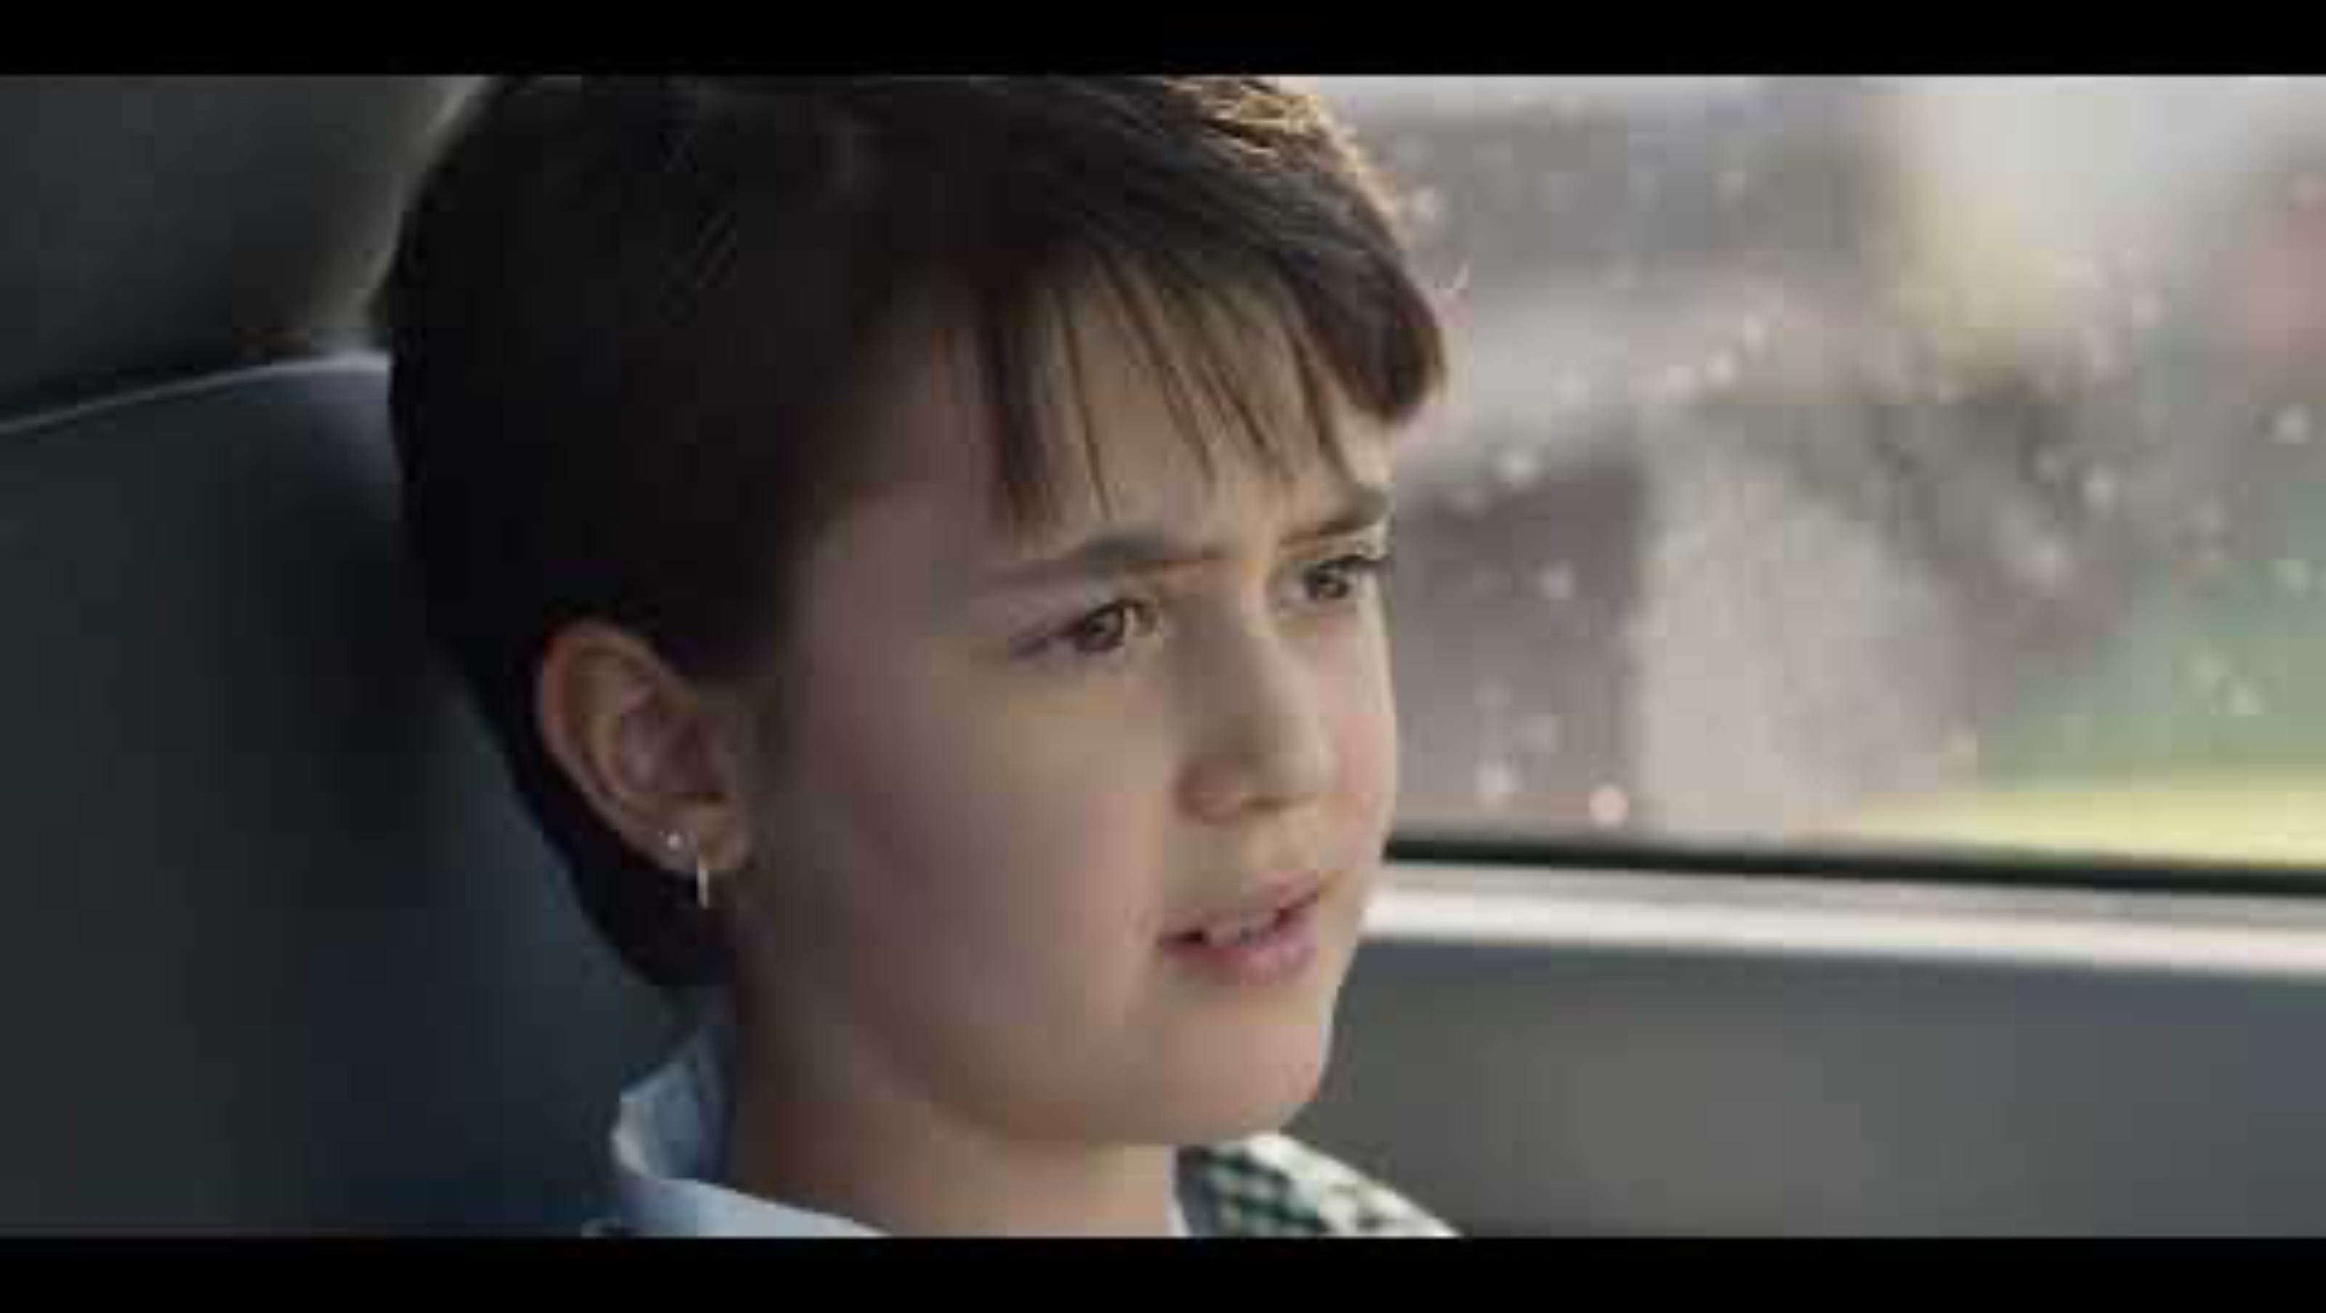
Notes:
https://www.youtube.com/watch?v=tIAnhDvuslk
0:30secs
Make Smoking History
Anyone who smokes, parents of young children who smoke.
Quit smoking, especially around young people and consider the long-term consequences.

Slide 68
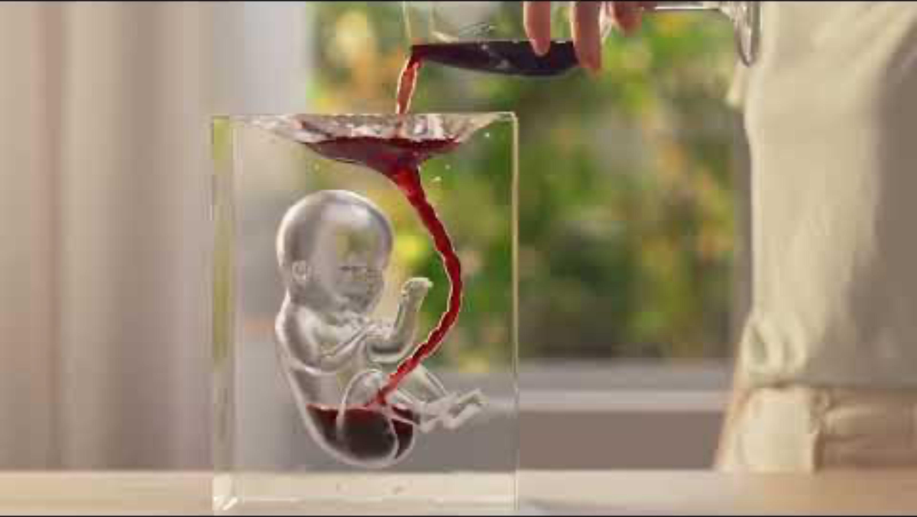
Notes:
https://www.youtube.com/watch?v=_nmokvjMISA
0:30secs
Alcohol. Think Again.
Pregnant women, friends/families of pregnant women.
Discouraging drinking alcohol while pregnant due to the effects it can have on the baby.

Slide 69

Tie it all together
Health Promotion is all about empowering people to feel in control of their health.
Health promotion campaigns try to show the ‘WHY’ and the ‘HOW’ to achieve that.
By having the knowledge and skills to make healthy decisions (from health promotion) regarding our health, we can try to minimise the negative impacts of the (controllable) determinants of health.

Slide 70
Assessment Task 4: Impacts on health
Introduce assessment task.
By the end of the lesson, students need to have decided which health promotion campaign they will analyse for their assessment.
Any time remaining can be spent researching for this task.
Notes:
ALTERNATIVE – complete the R U OK analysis in this lesson if time permits.

Slide 71
NEXT WEEK:
Over the next week make sure you have chosen what campaign you will focus on for your assignment.
You can begin your research this week and ask any questions next week.
Due: Week 6.
Analyse 'R U OK? Day' Health Promotion Campaign.
Class time to complete your assignment.

Slide 72
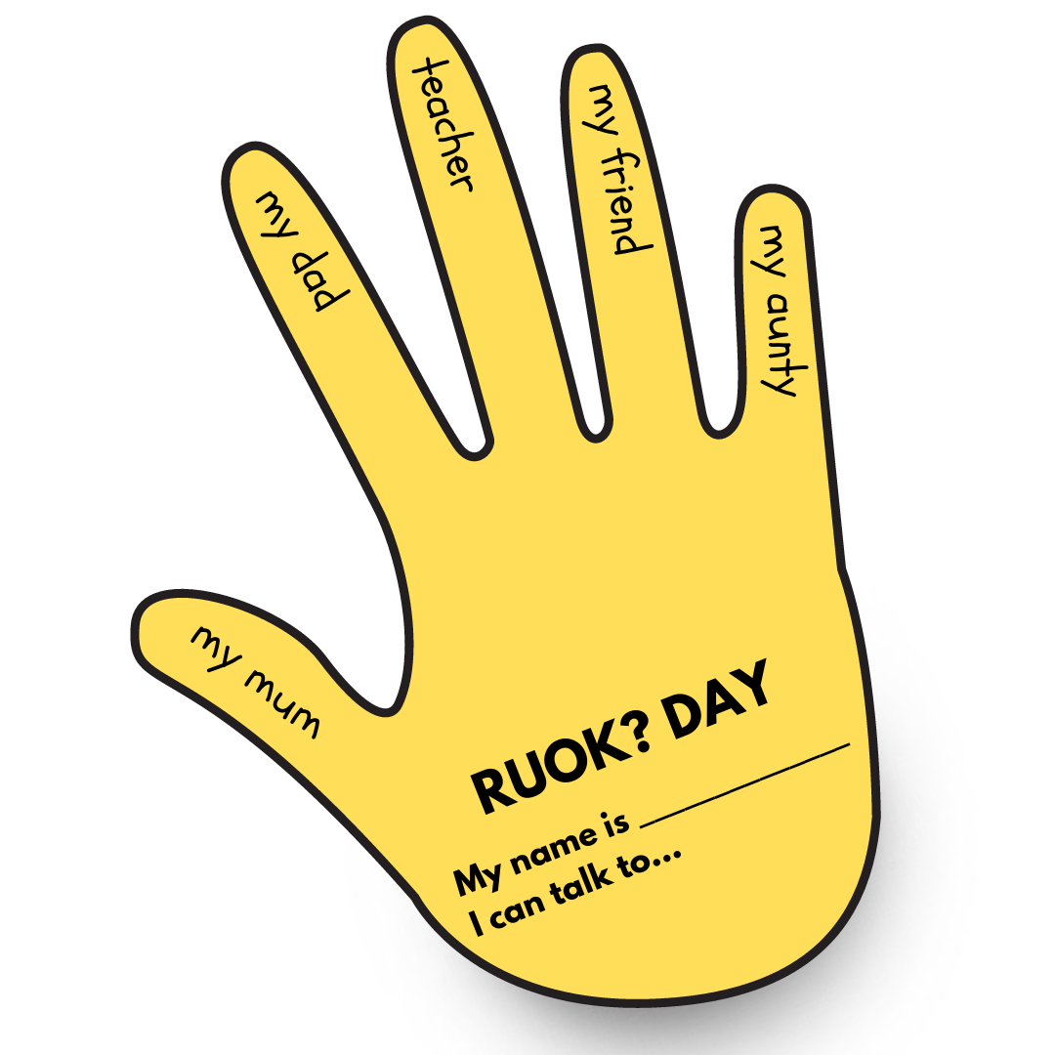
EXIT TICKET: (PG.23)
Think about the people in your life that you can go to if you ever need help or a chat.
Complete the R U OK? Hand template in your books by listing 5 different people in your life that are a part of your support network.
Once you have completed this, show your teacher and then pack up.

Slide 73
IMPACTS On Health
Year 10 Health Lesson 5 Term 3, 2024

Slide 74
Today’s Focus
Analyse ‘R U OK’ Day campaign
Assessment time
Due week 6

Slide 75
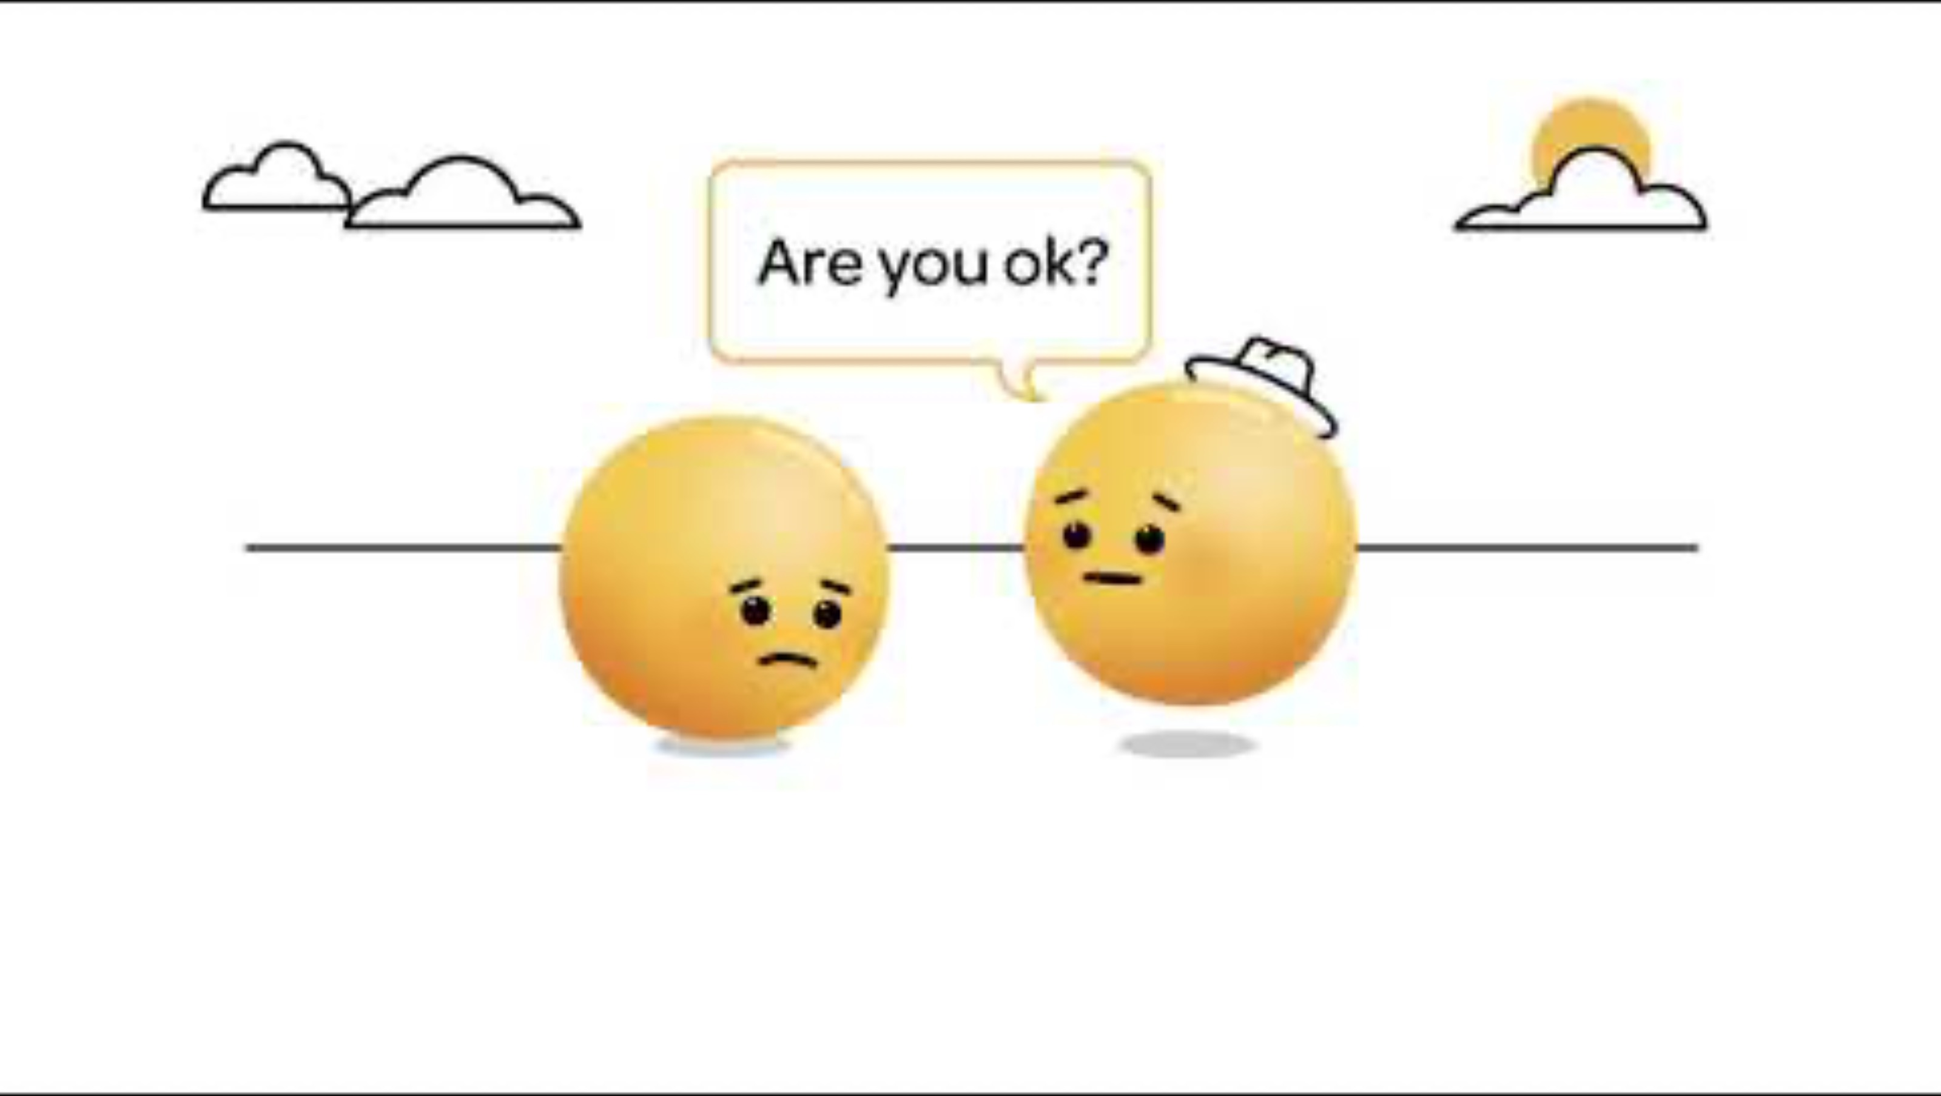
R U OK? Day (PG.21-22)
R U OK? Day is a health promotion campaign all about encouraging people to start the conversation and ask, “R U OK?”
It helps to bring awareness to suicide and mental health and normalise asking, and talking, about our feelings and creating a sense of connectedness.
One conversation can change a life.
Notes:
TW – Suicide references.
https://www.youtube.com/watch?v=gfq7SHXCvNg
0:15sec
ALTERNATIVE:
Introduce assignment first.
Instruct students to all choose a health promotion campaign (while it’s fresh in their minds).
Start working on assignment. Students can attempt to start their assignment before next week’s class.
Then next week do the R U OK analysis, followed by class time for the assignment.

Slide 76

The man behind ‘R U OK? Day’
Watch the video: https://www.ruok.org.au/our-story#:~:text=In%201995%2C%20much%2Dloved%20Barry,. (2:49mins)
In 1995, much-loved Barry Larkin was far from OK. His suicide left family and friends in deep grief and with endless questions. In 2009, his son Gavin Larkin chose to champion just one question to honour his father and to try and protect other families from the pain his endured: 'Are you OK?’.
While collaborating on a documentary to raise awareness, the team quickly realised the documentary alone wouldn’t be enough. To genuinely change behaviour Australia-wide, a national campaign was needed. And from this realisation, and with Gavin and his colleague's expertise and passion, R U OK? was born.
Gavin remained a passionate champion of the fact a conversation could change a life, even as cancer ended his in 2011. His legacy is a national Conversation Movement that is equipping Australians with the skills and confidence to support those struggling with life.
R U OK? was born from lived experience. The valuable insights, storytelling, and expertise of those with lived experience continues to be weaved throughout everything we do. Across our team, Board, Advisory Groups and Ambassadors, we remain respectful and proud of those who share their journeys to help continually improve our work.
Notes:
TW – Suicide references.
https://www.ruok.org.au/our-story#:~:text=In%201995%2C%20much%2Dloved%20Barry,.
2:49mins
- Shorter video to provide some background information about R U OK Day and how it started.

Slide 77
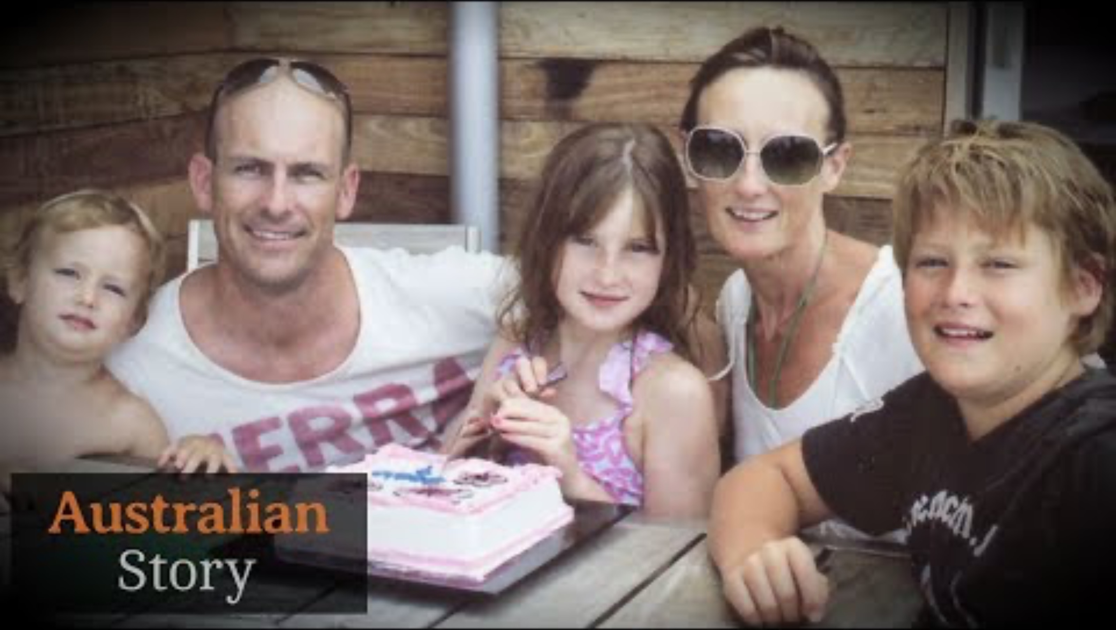
Beyond OK: Gavin Larkin, the man behind R U OK? Day | Australian Story
Notes:
OPTIONAL
TW – Suicide references.
https://www.youtube.com/watch?v=4GhzjNdu83w&t=8s
8:42mins

Slide 78
A closer look at the campaign… (PG.21-22)
Complete the table in your workbooks about the RUOK? Day health campaign.
Provide an overview of both the Health topic and campaign chosen
Mental health is a growing concern in Australia. The R U OK campaign was started in 2009
WHO – is the health promotion targeting? - use an example from the campaign which supports your answer.
Passer-by people who regularly forget to ask a simple question.
Targeting anyone - aimed at everyone.
Aimed primarily at people to try and limit mental illness before it gets too late to do anything. (Prevention is better than cure).
Notes:
Relevant to assignment: Instruct students that for their assignment they will need to choose a health promotion campaign that currently exists and investigate the answers to these questions for their chosen campaign.
ALTERNATIVELY, depending on time – you can do this as a class discussion where students follow along and fill in the table in their books, OR you can allow students time to research themselves using the website www.ruok.org.au
ALTERNATIVE:
Introduce assignment first, before analysing the R U OK? campaign.
Instruct students to all choose a health promotion campaign (while it’s fresh in their minds).
Start working on assignment. Students can attempt to start their assignment before next week’s class (week 5).
Then in week 5 you can do the R U OK analysis, followed by class time for the assignment.

Slide 79
HOW – two ways/methods does the campaign raise awareness for the identified target audience?
Quick effective language abbreviations - easy to remember.
Use of Aussie slang (OK), wrist bands, huge nationwide campaign - using lots of media formats, using personalised stories - makes it seem real, bright colours.
WHAT – attitudes/beliefs are the campaign trying to change AND how does this influence a change in health behaviour?
Don't ignore friends and family if you feel something is wrong - make a point of staying connected. Slow down and remember the people who are important in your life.
Notes:
Relevant to assignment: Instruct students that for their assignment they will need to choose a health promotion campaign that currently exists and investigate the answers to these questions for their chosen campaign.
ALTERNATIVELY, depending on time – you can do this as a class discussion where students follow along and fill in the table in their books, OR you can allow students time to research themselves using the website www.ruok.org.au
ALTERNATIVE:
Introduce assignment first, before analysing the R U OK? campaign.
Instruct students to all choose a health promotion campaign (while it’s fresh in their minds).
Start working on assignment. Students can attempt to start their assignment before next week’s class (week 5).
Then in week 5 you can do the R U OK analysis, followed by class time for the assignment.

Slide 80
WHY – should this health focus be important to the nation? Why is this health campaign needed? (show statistics/data to support your answer)
In each year, approximately one in every five Australians will experience a mental illness.
Mental illnesses are the third leading cause of disability burden in Australia, accounting for an estimated 27% of the total years lost due to disability.
About 4% of people will experience a major depressive episode in a 12-month period, with 5% of women and 3% of men affected.
Approximately 14 % of Australians will be affected by an anxiety disorder in any 12- month period.
About 3% of Australians are affected by psychotic illness; such as schizophrenia, where there is a loss of contact with reality during episodes of illness.
Approximately 2% of Australians will experience some type of eating disorder in their life, with women 9 times more likely than men.
About 5% of Australians will experience substance abuse disorders in any 12- month period, with men more than twice as likely as women to have substance abuse disorders.
Prevalence of mental illness decreases with age, with prevalence greatest among 18-24 year olds.
Women are more likely than men to seek help for anxiety disorders (18% compared with 11%) and mood disorders (7.1% compared with 5.3%).
A national survey showed that 35% of people with a mental disorder had used a health service and 29% consulted a GP within the 12 months before the survey.
Women are more likely than men to use services for mental health problems.
Limited research suggests that Aboriginal and Torres Strait Islander people experience mental disorders at least as often as other Australians.
Notes:
Ask students to only write down 3 statistics for this activity.
Relevant to assignment: Instruct students that for their assignment they will need to choose a health promotion campaign that currently exists and investigate the answers to these questions for their chosen campaign.
ALTERNATIVELY, depending on time – you can do this as a class discussion where students follow along and fill in the table in their books, OR you can allow students time to research themselves using the website www.ruok.org.au
ALTERNATIVE:
Introduce assignment first, before analysing the R U OK? campaign.
Instruct students to all choose a health promotion campaign (while it’s fresh in their minds).
Start working on assignment. Students can attempt to start their assignment before next week’s class (week 5).
Then in week 5 you can do the R U OK analysis, followed by class time for the assignment.

Slide 81
The remaining question is your opinion developed from your knowledge and research on the topic and campaign.
REVIEW – analyse the campaign and discuss (in detail) one positive and one area for improvement that could be implemented to enhance the campaign results.

Slide 82

Assessment Task 4: Impacts on health
Complete your assessment task.
DUE: NEXT WEEK (week 6)

